Slide 1
LESSON4U APPLICATION
Presenting – Yahav Karpel, Oriel Malihi , Daniel Korotine, Shoval Benayon

Slide 2
TABLE OF CONTENTS
01
02
03
04
Overview
UML diagrams
Application & firebase
Gaps

Slide 3
01
overview

Slide 4
INTRODUCTION
Many students look for private lessons in many ways - through ads, Facebook, groups, people who have taken private lessons, etc.
During the search one encounters search problems and energy waste.
That's why we created the app that comes to make it easier for users to search for private lessons in all professions and levels.
In a simple and effective search, we can find private lessons through a simple search that suits our needs.

Slide 5
—Brain Herbert
“the capacity to learn is a gift, the ability to learn is a skill, the willingness to learn is a choice.”

Slide 6
02
UML diagrams

Slide 7
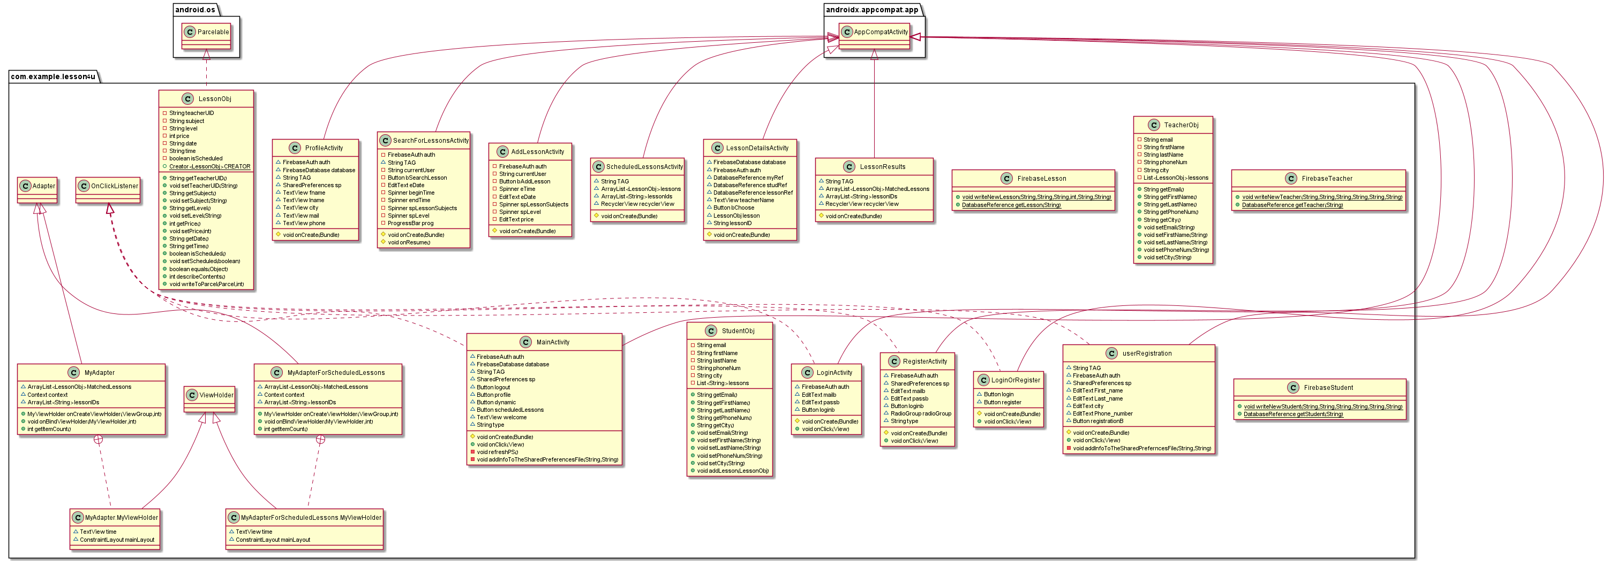
Class UML

Slide 8
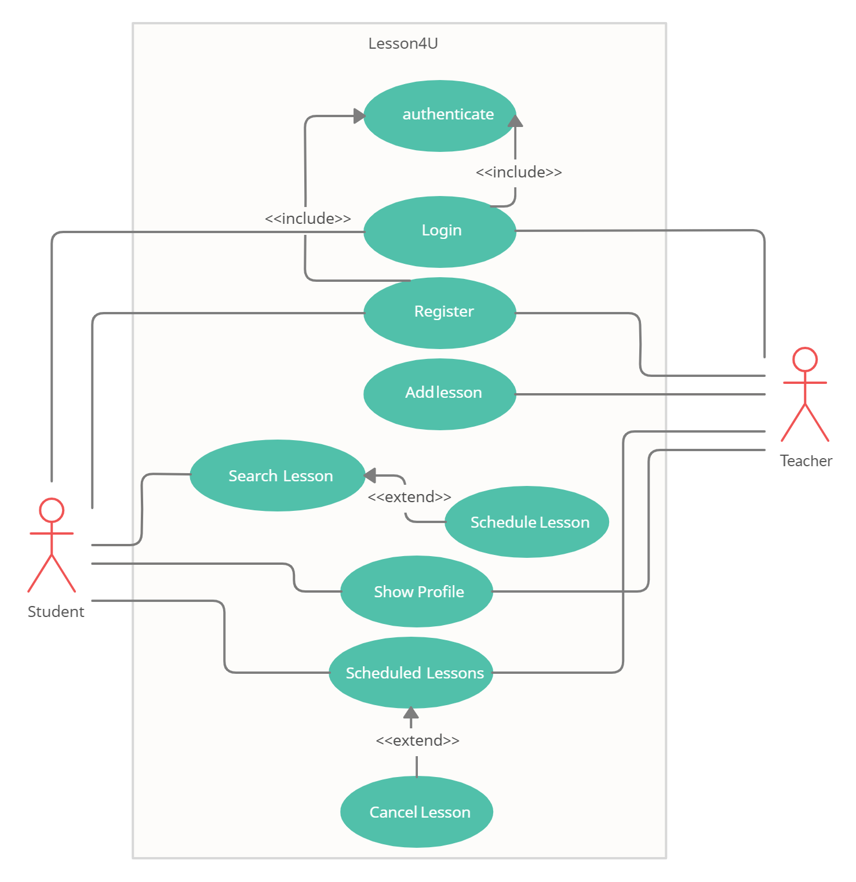
Use case diagram

Slide 9
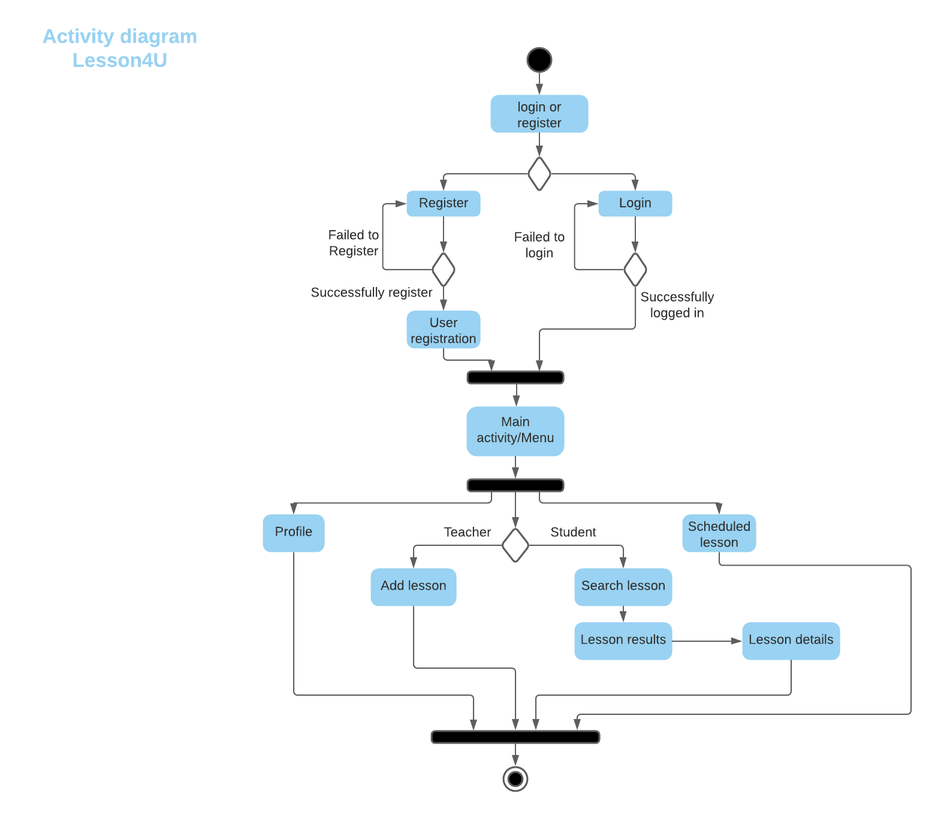
Activity Diagram

Slide 10
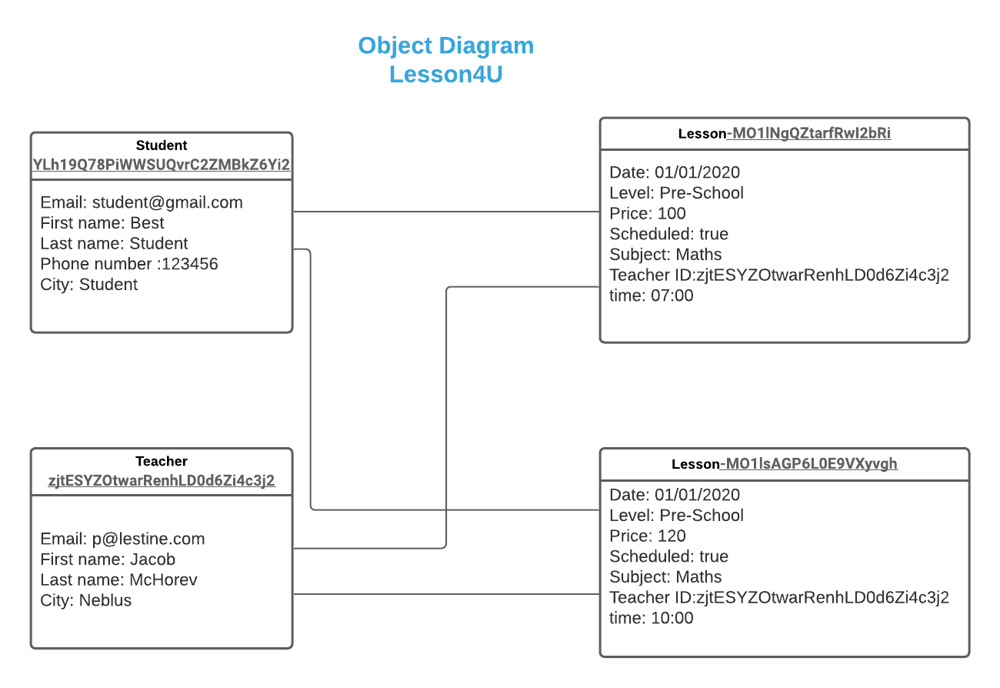
object Diagram

Slide 11
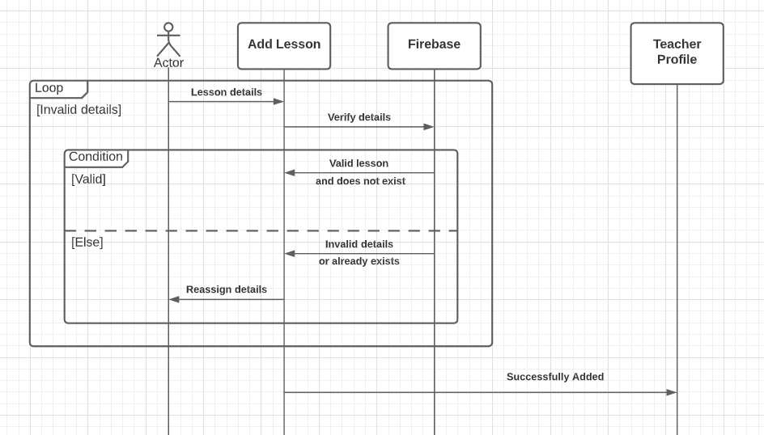
sequence Diagram

Slide 12
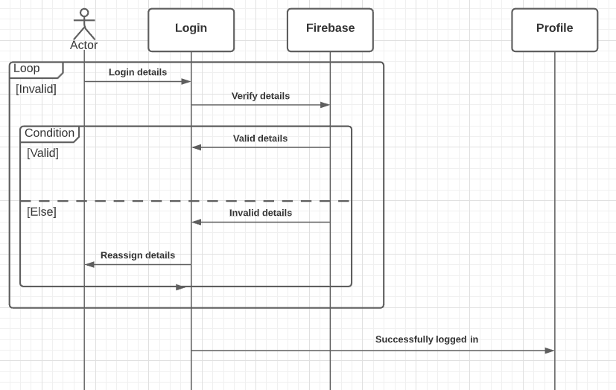
sequence Diagram

Slide 13
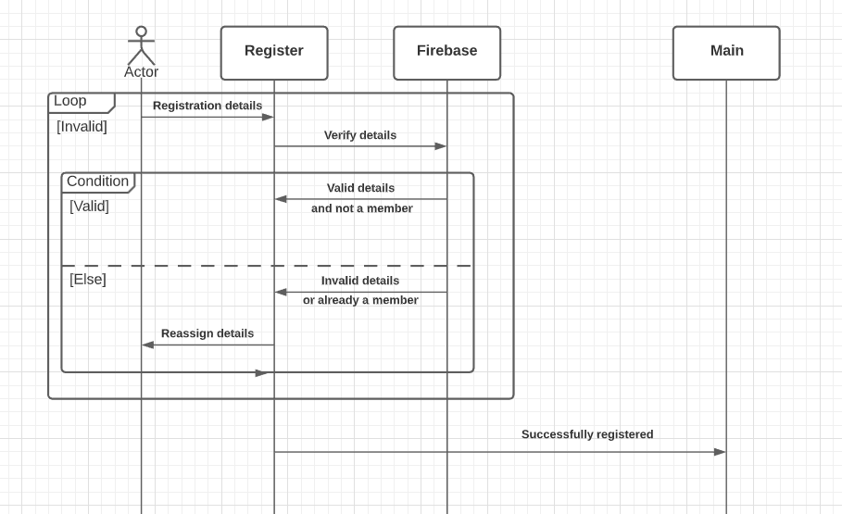
sequence Diagram

Slide 14
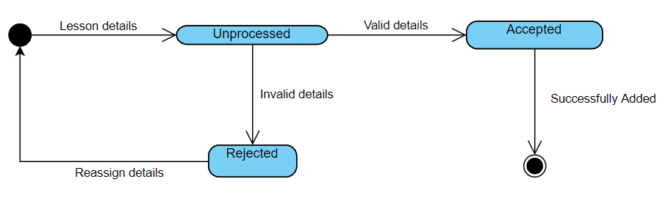
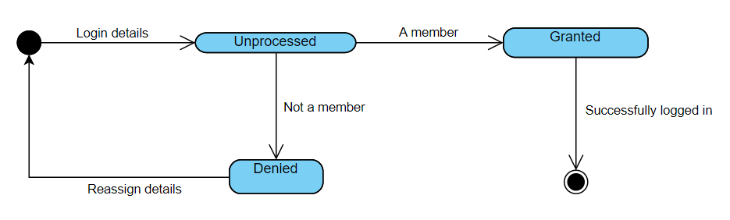
State machine Diagram

Slide 15
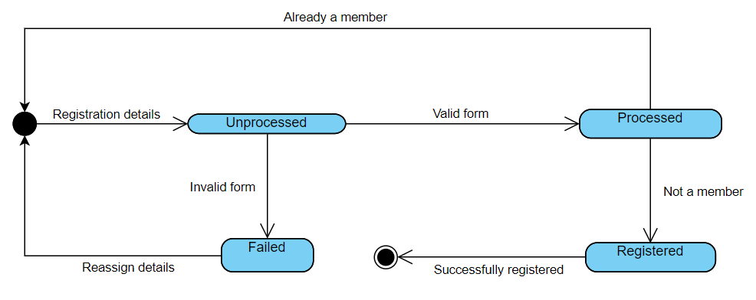
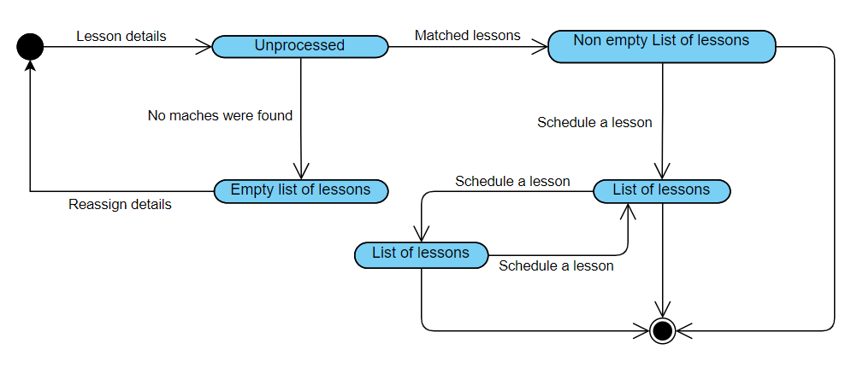
State machine Diagram

Slide 16
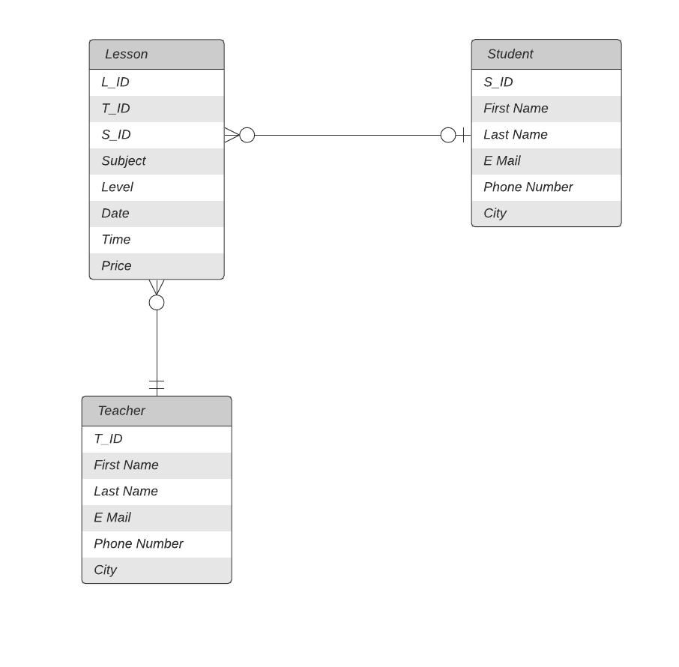
ERD

Slide 17
03
Application& firebase

Slide 18
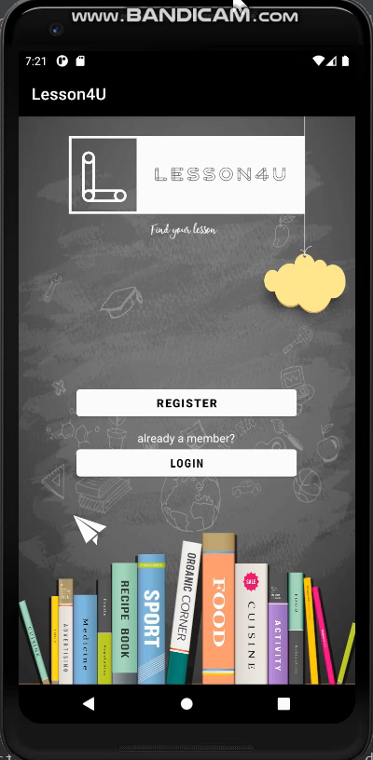
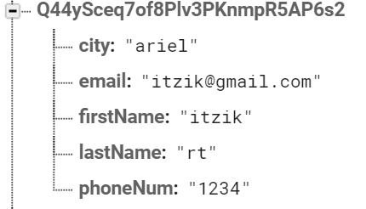
Registration& login example :
First the user enter mail and password and if he is a teacher or student
Then the user complete his registration by entering phone number, name, etc.
The user enter his mail and password and if its correct, the user will be logged in.
We will get a toast if the login was successful or failed

Slide 19
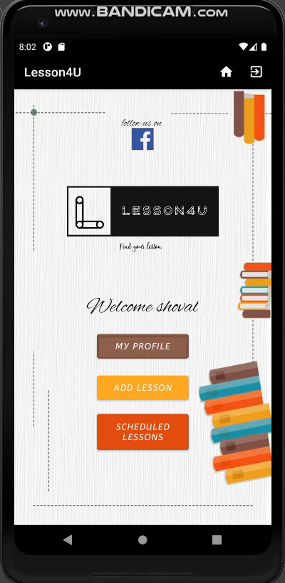
teacher
Add lesson example :
The teacher will fill in all the required fields according to the lesson he wants to teach.
We will get a toast if the action was successful or failed

Slide 20

student
Search lesson example :
The student will fill in all the required fields according to the lesson he wants to learn.
We will get a toast if the action was successful or failed

Slide 21

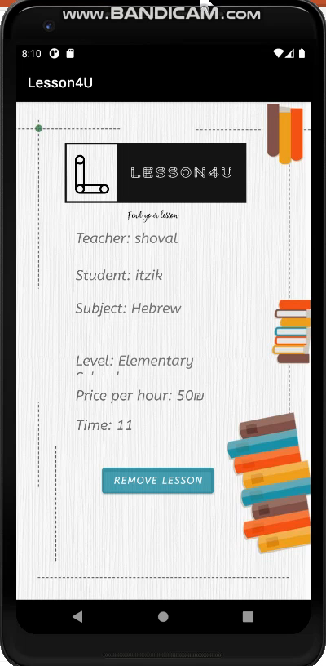
Teacher + Student
Scheduled lessons example :
Student and teacher can see theirs future lessons at schduled lessons activity

Slide 22
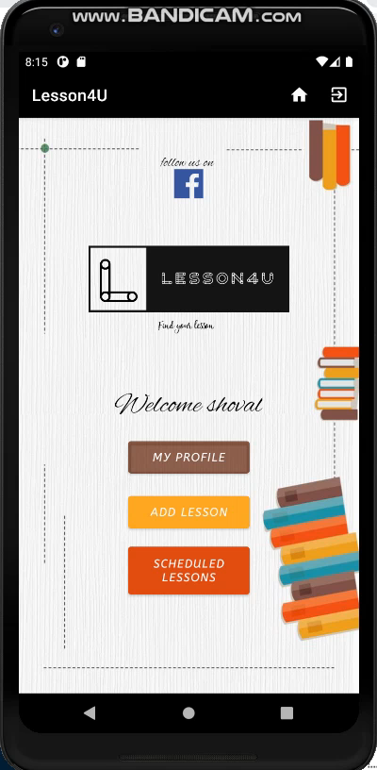
teacher & student
Facebook example :
By clicking on the facebook icon , you will move to a group designed for our Facebook app

Slide 23
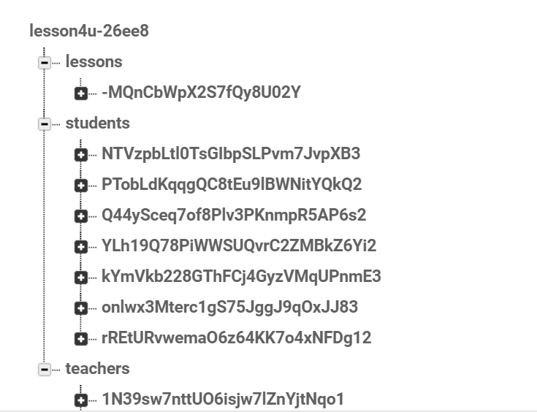
FIREBASE

Slide 24
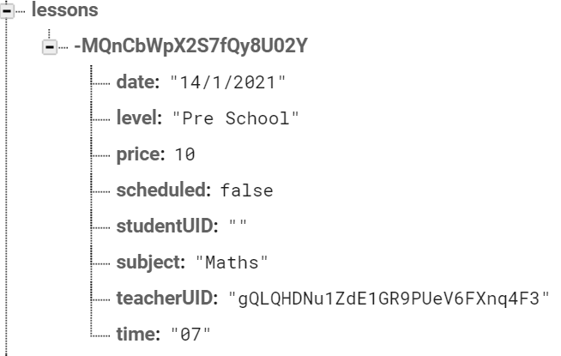
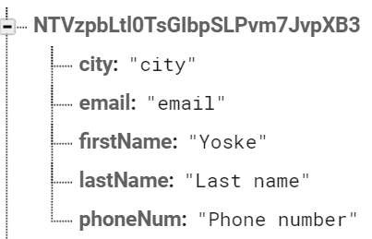
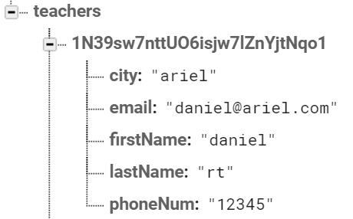
FIREBASE
LESSONS
STUDENTS
TEACHERS

Slide 25
04
GAPS

Slide 26
PROBLEM
SOLUTION
In one of our requirements, we wanted to create an option where students who had studied with a teacher would be able to rate him
We have created a Facebook page where all students and teachers can post information, they feel is necessary for the benefit of all

Slide 27
OUR GITHUB:
https://github.com/orielmalihi/Lesson4U
THANK YOU!

